Slide 1
TensorFlow
basics

Slide 2
TensorFlow
Tensor + Flow
Tensor: n-dimensional arrays
Vector: 1-dimensional tensor
Matrix: 2-dimensional tensor
Deep learning processes are flows of tensors
A sequence of tensor operations
Can also represent a number of machine learning algorithms

Slide 3
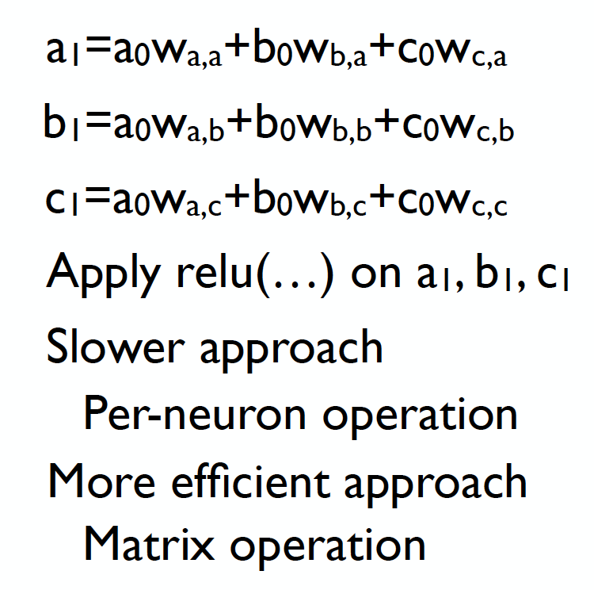
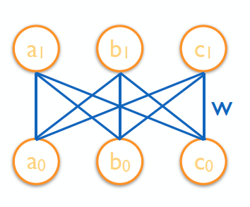
ReLU network
Outputs
Inputs

Slide 4
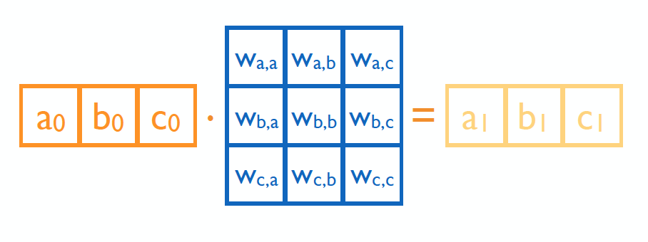
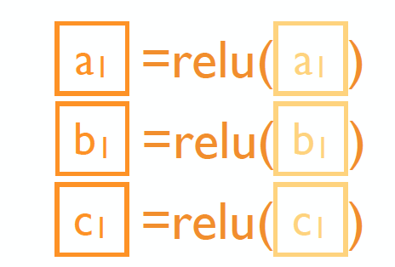
Matrix operation

Slide 5



In TensorFlow

Slide 6
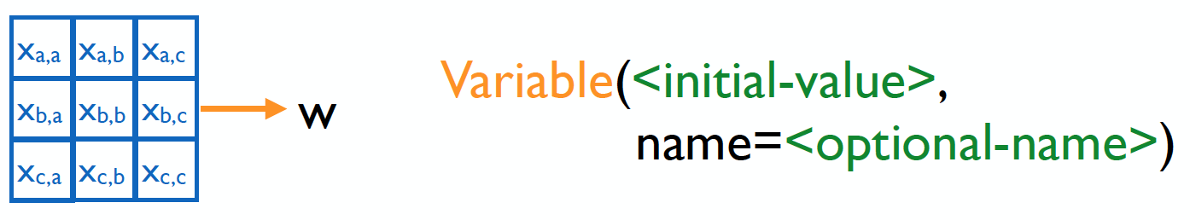
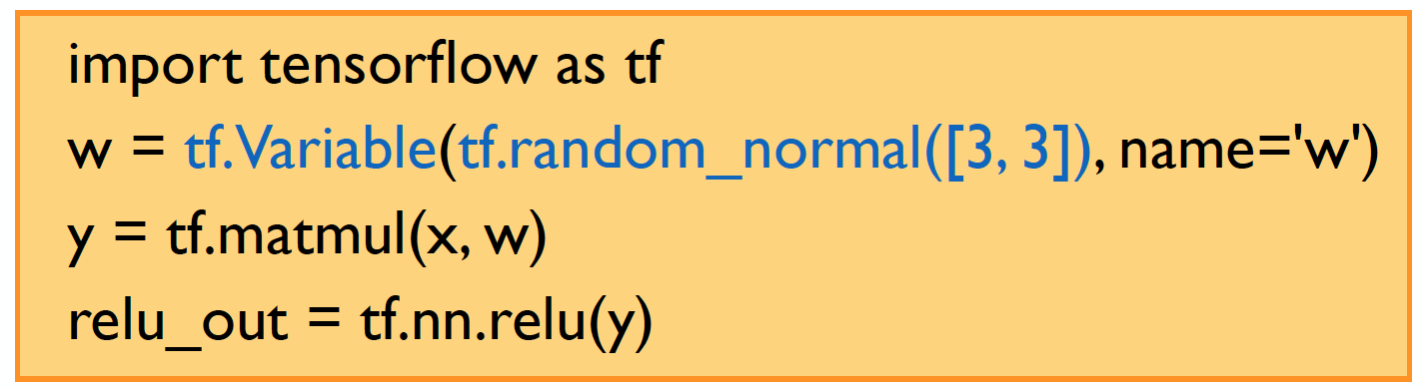
Variables

Slide 7
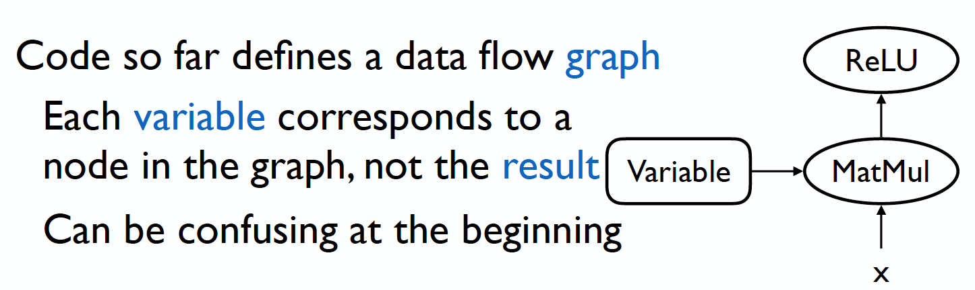
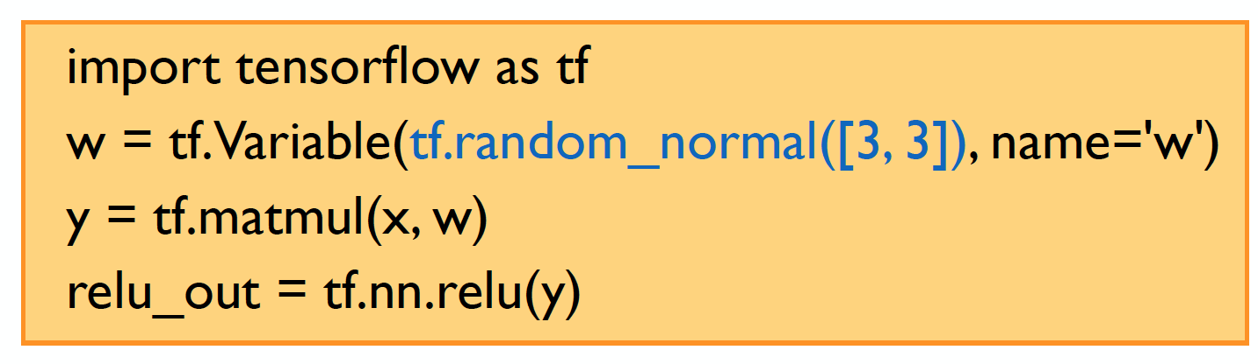
TensorFlow

Slide 8
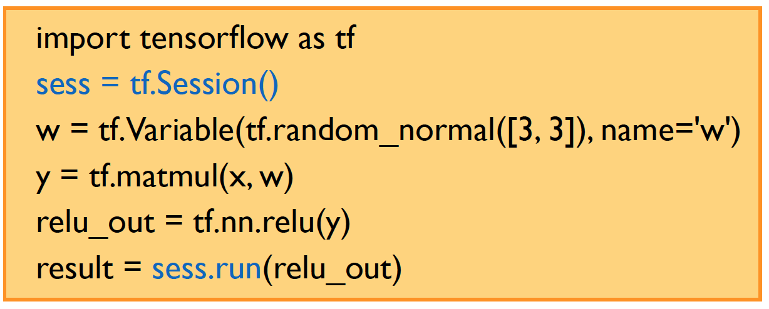
Session

Slide 9
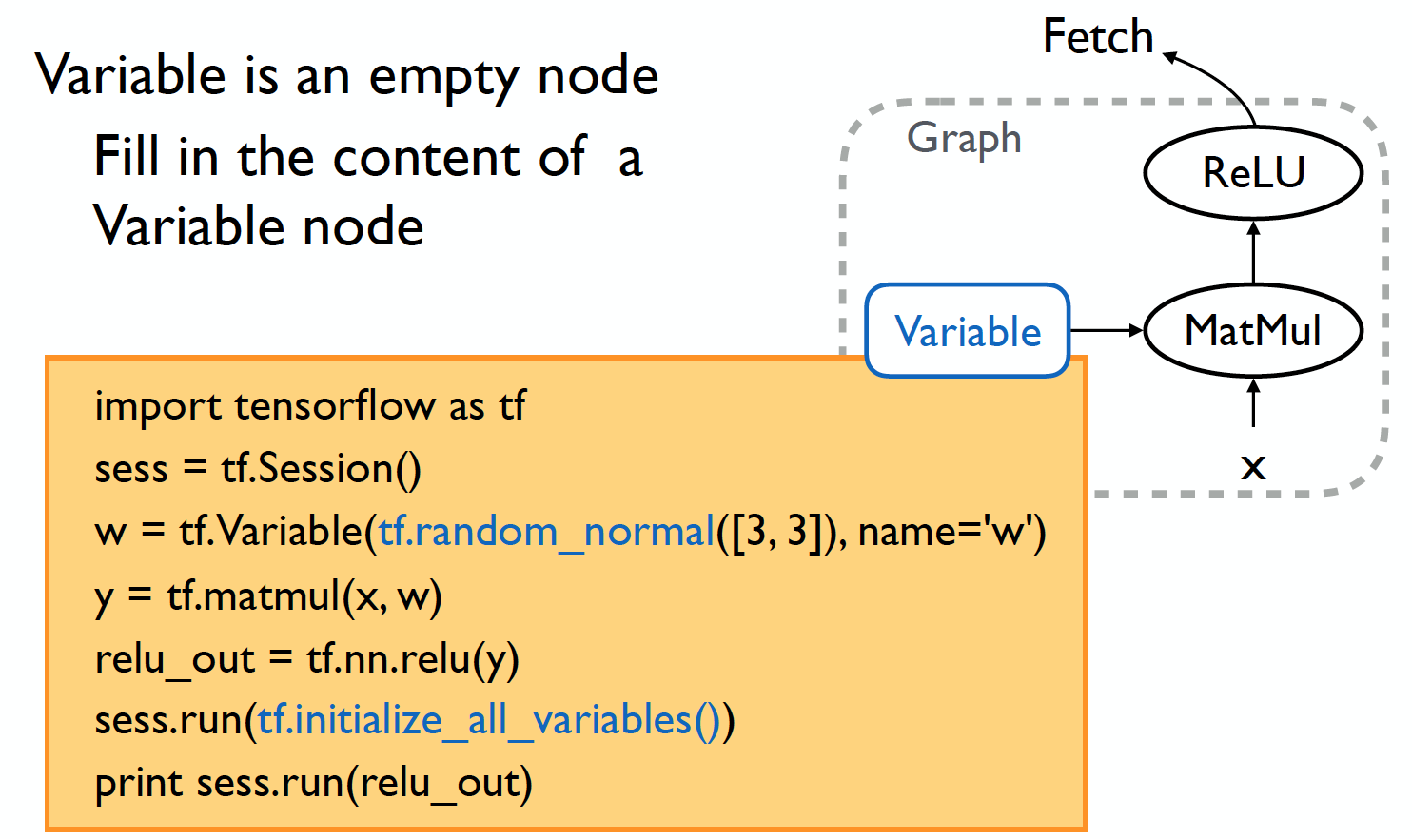
Initialize variable

Slide 10
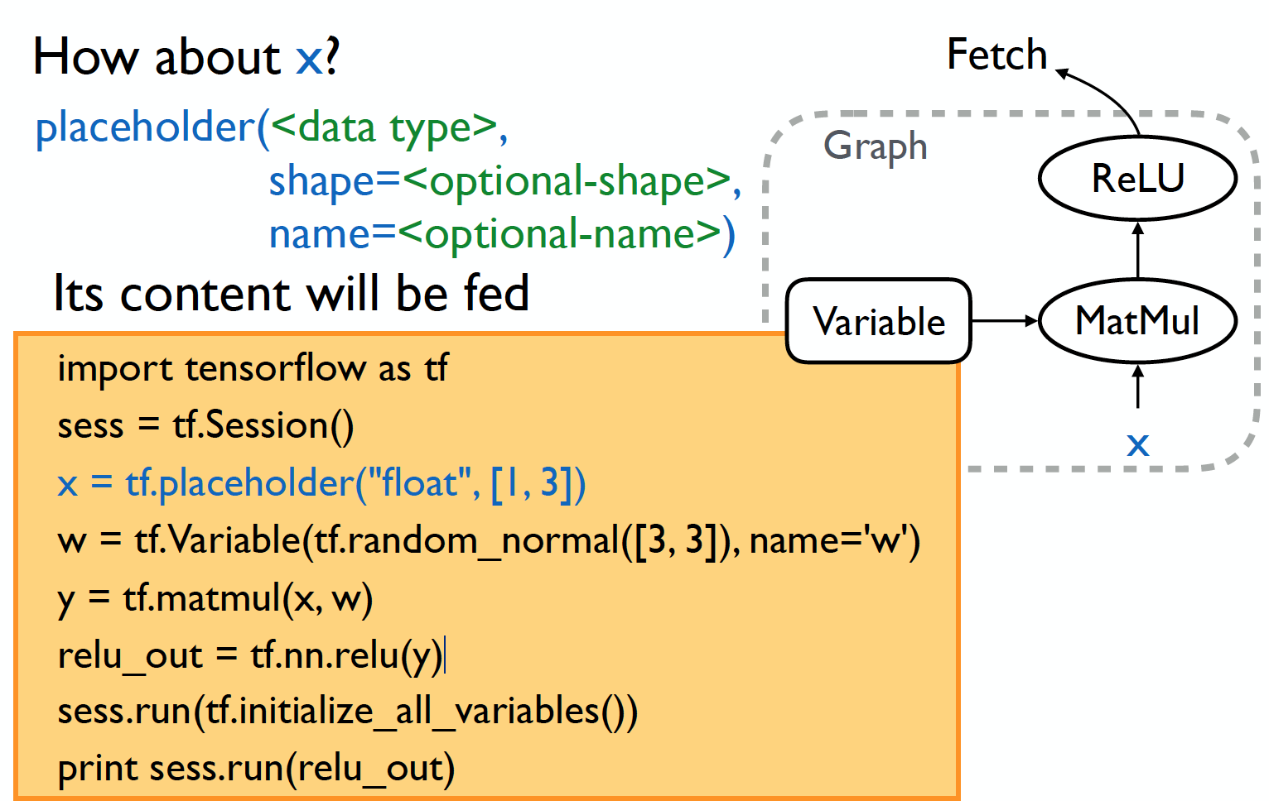
Placeholder

Slide 11
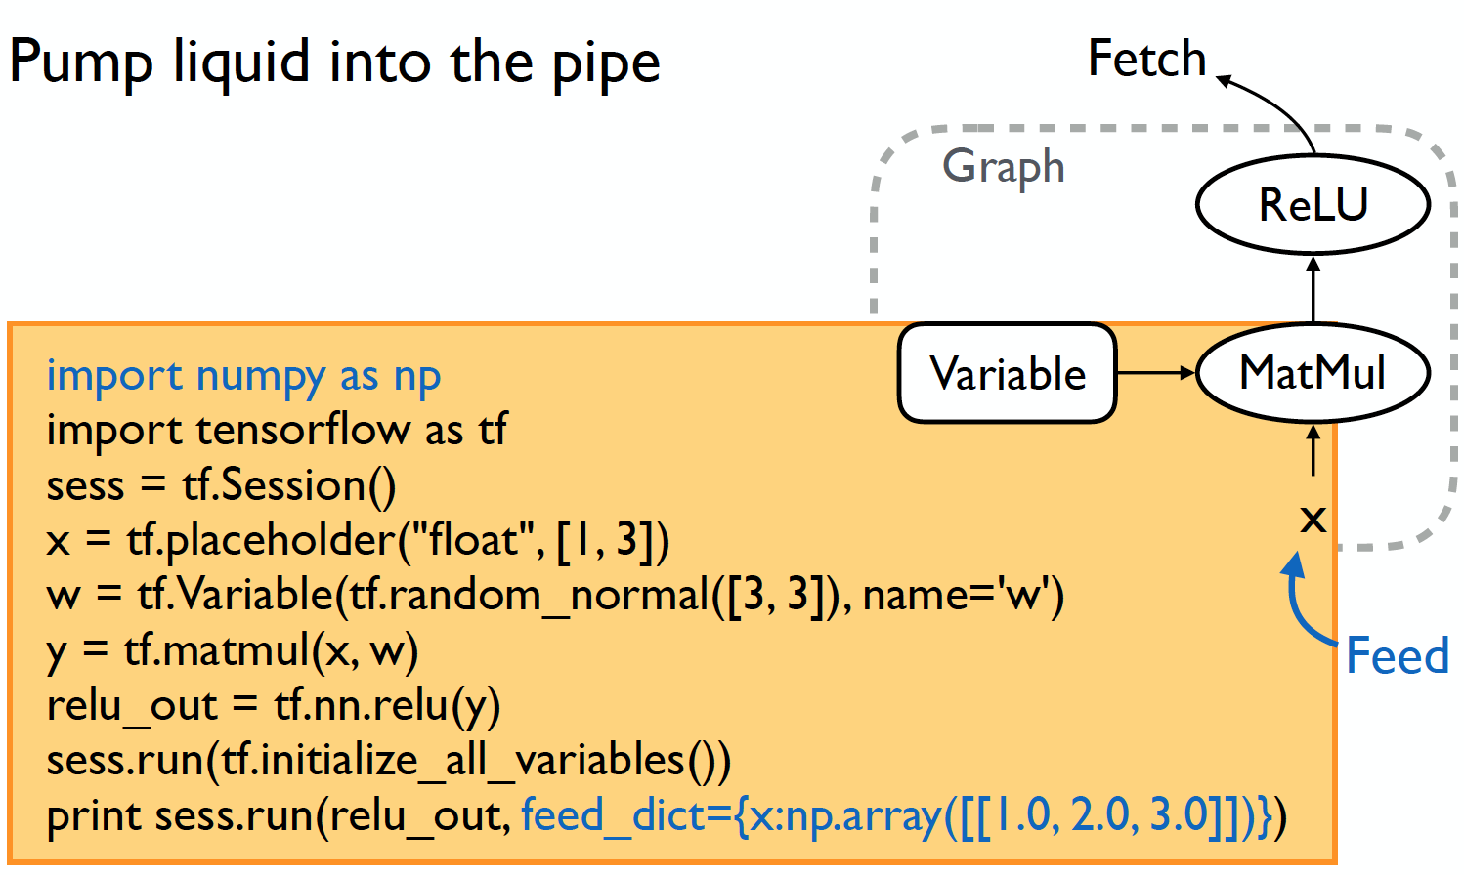
Feed

Slide 12
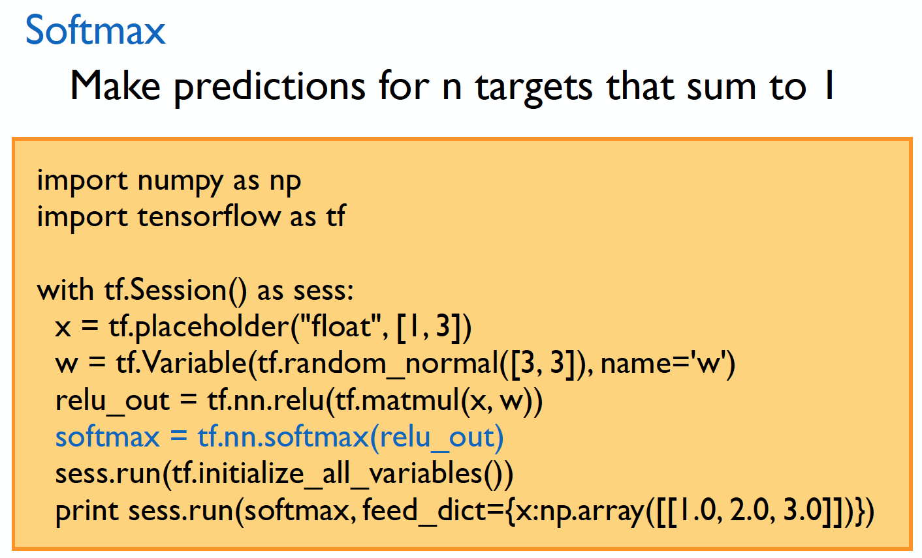
Prediction

Slide 13
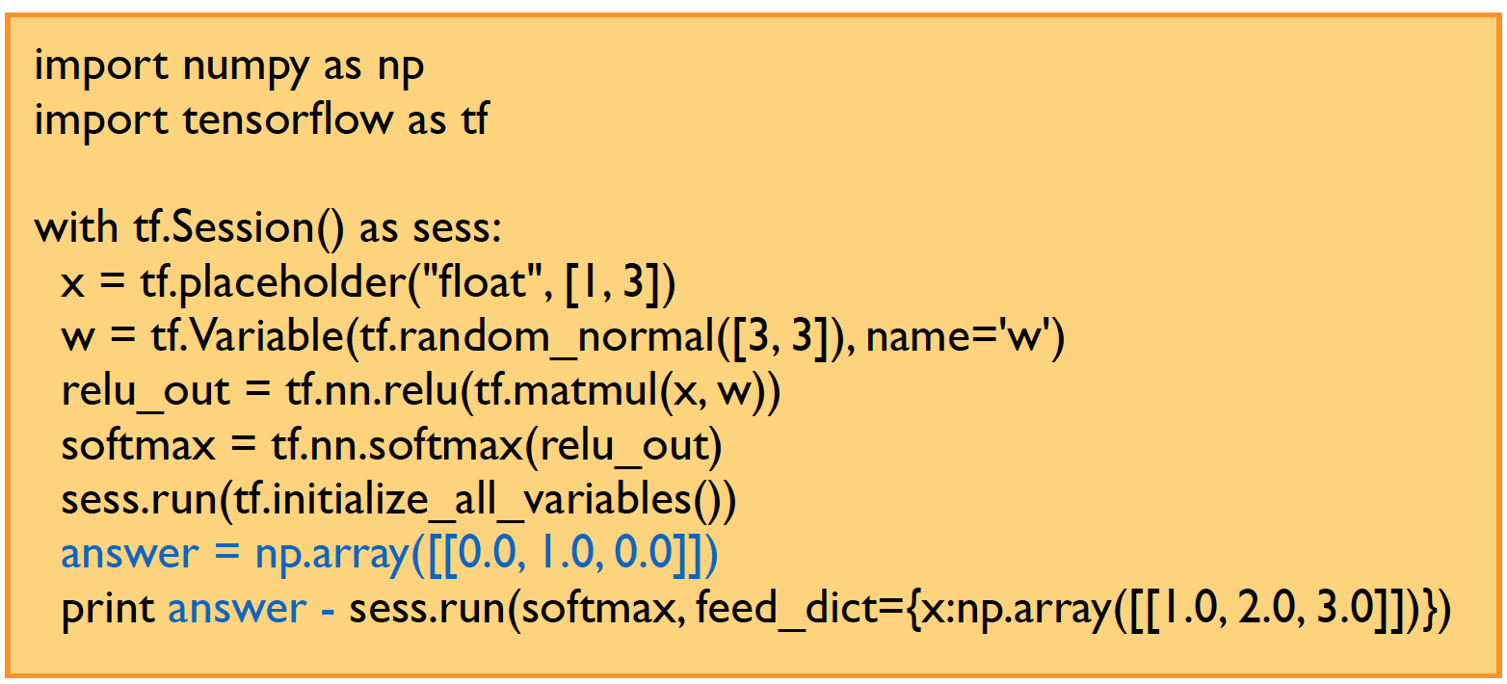
Error

Slide 14
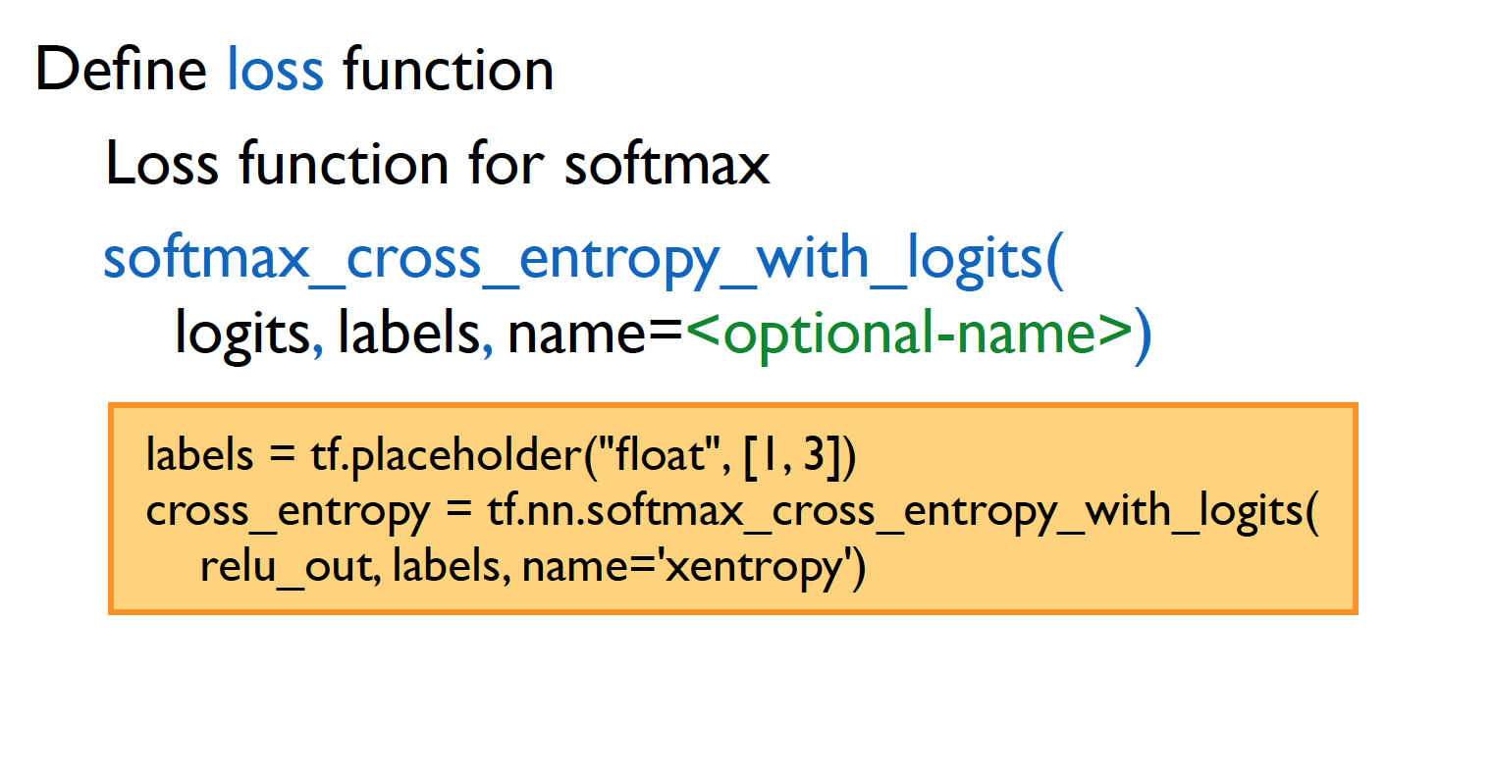
Loss

Slide 15
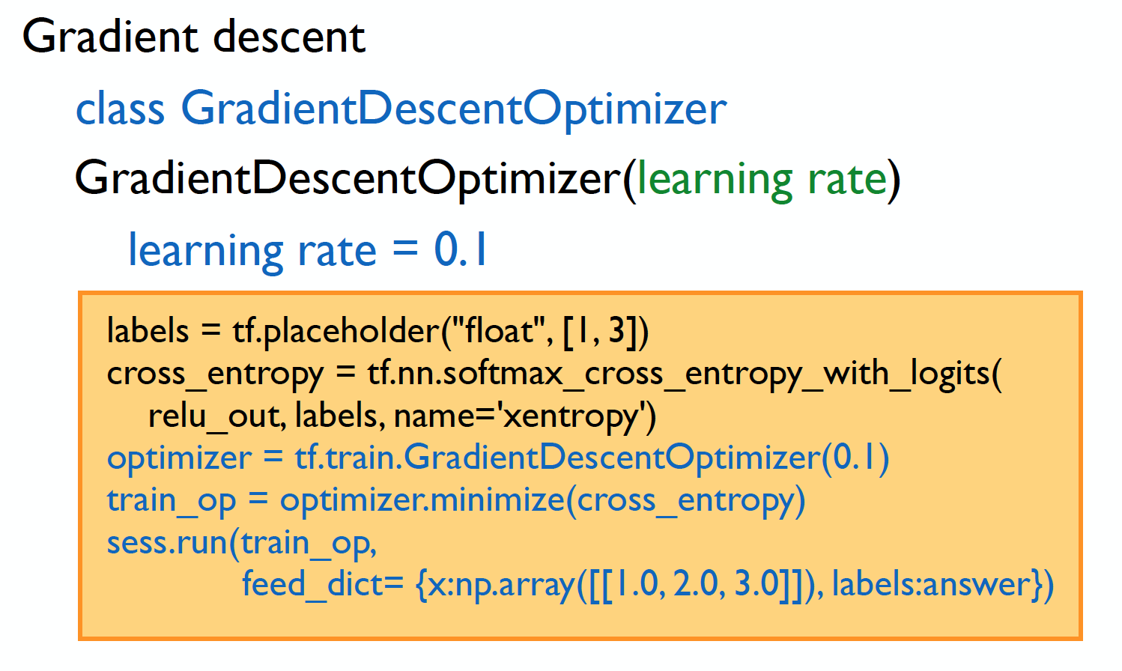
Optimization

Slide 16
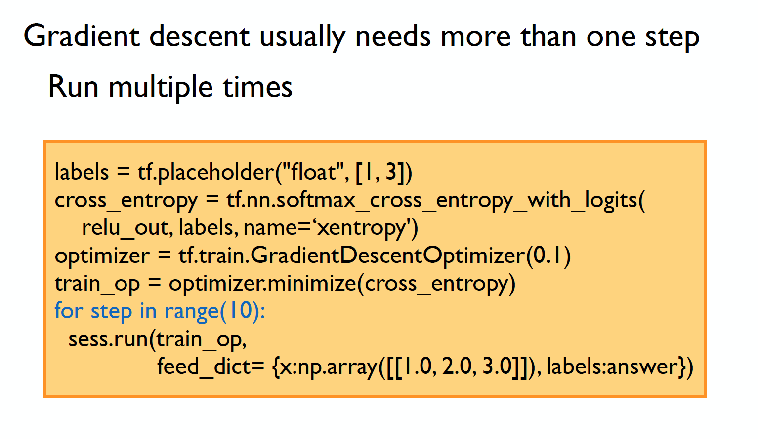
Iterative update

Slide 17
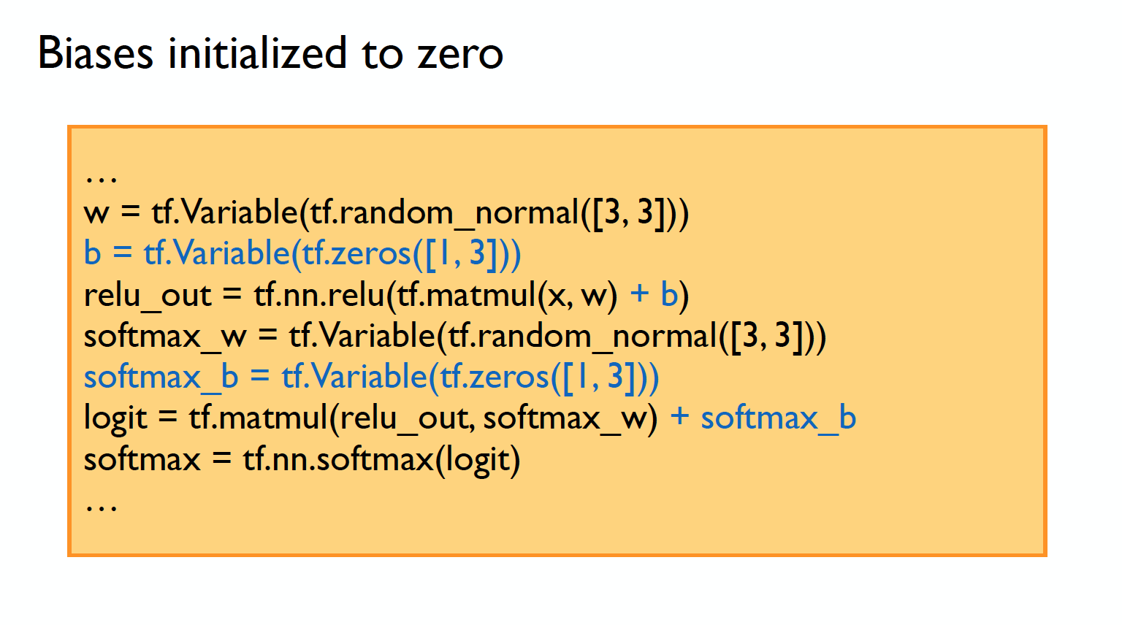
Biases

Slide 18
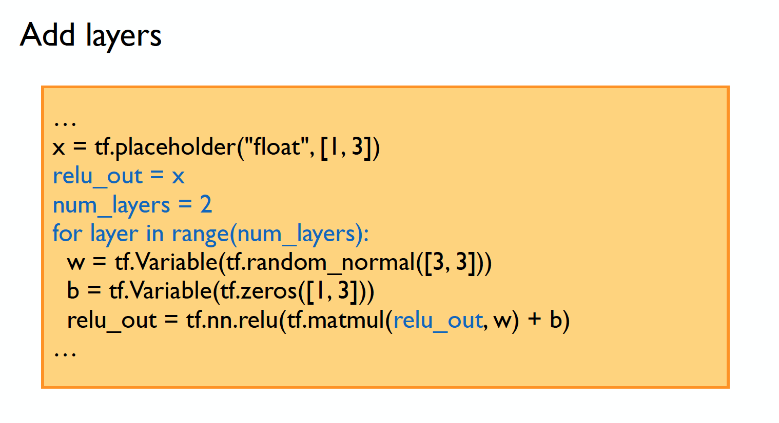
Go deeper

Slide 19
Summary
Computational Graph (TensorFlow)
Optimizer
Loss
Operation
Variable
PlaceHolder

Slide 20
Codes

Slide 21
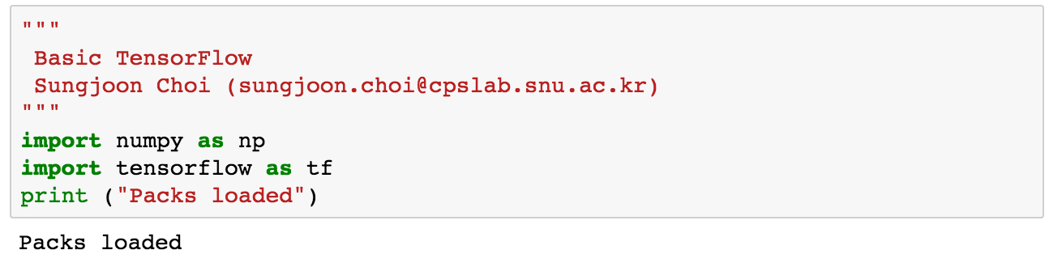
Packages

Slide 22
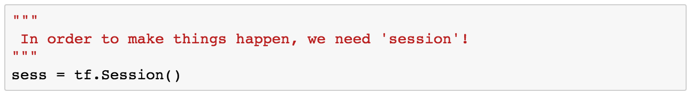
Session

Slide 23
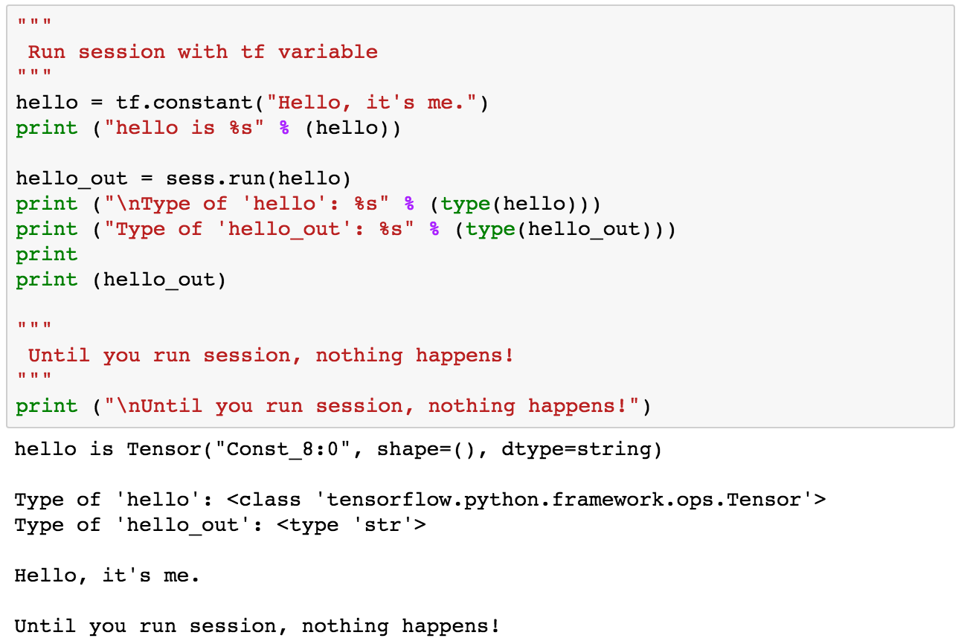
Run

Slide 24
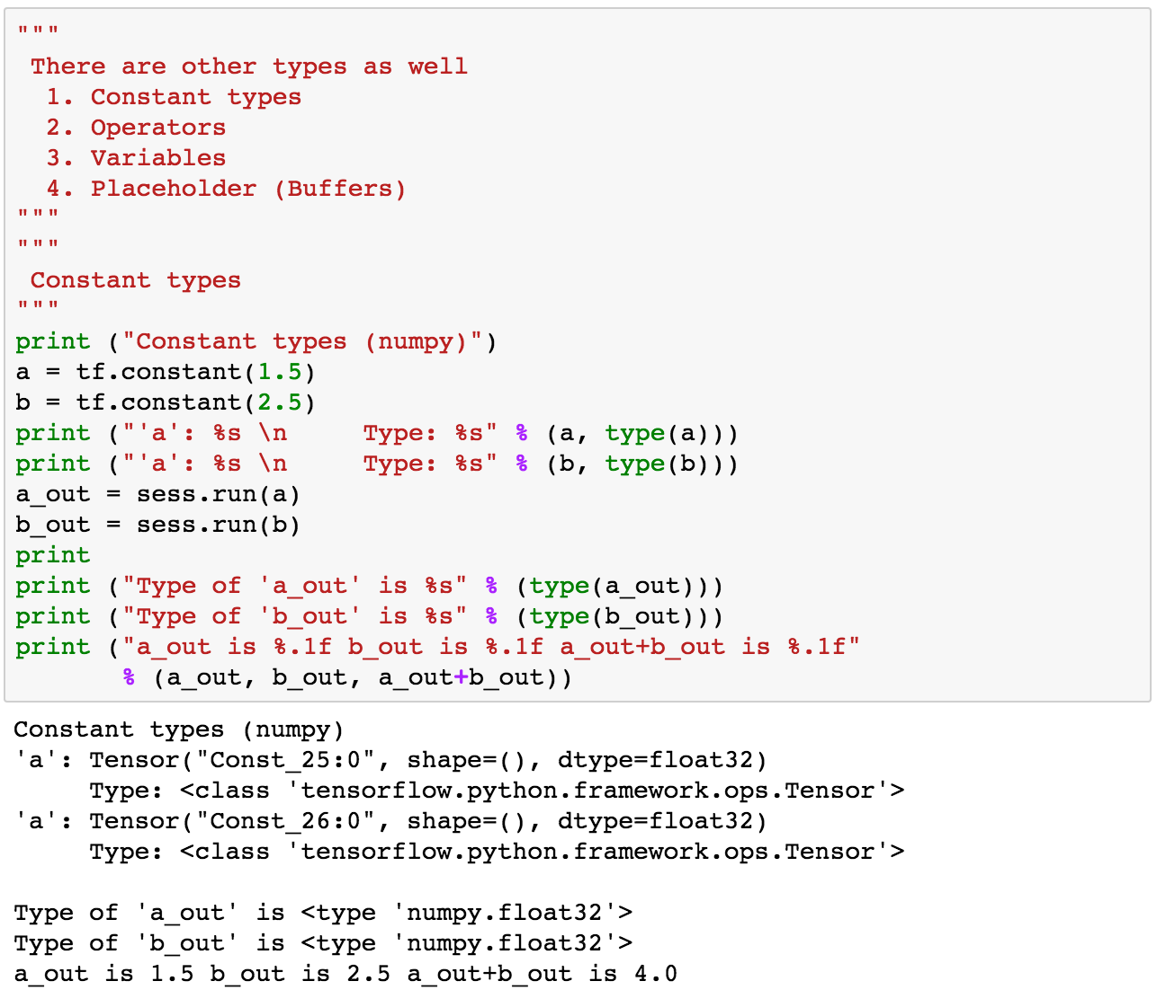
Constant

Slide 25
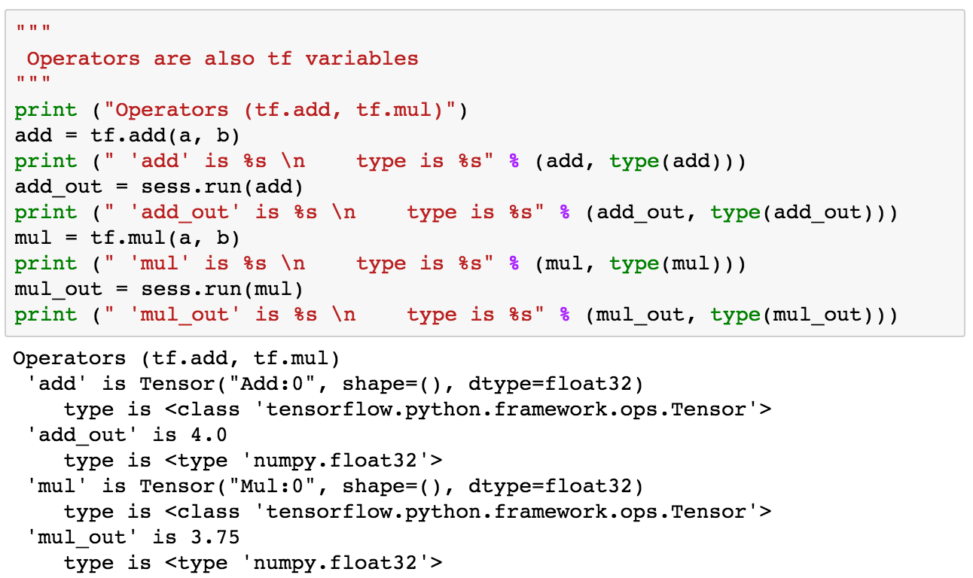
Operations

Slide 26
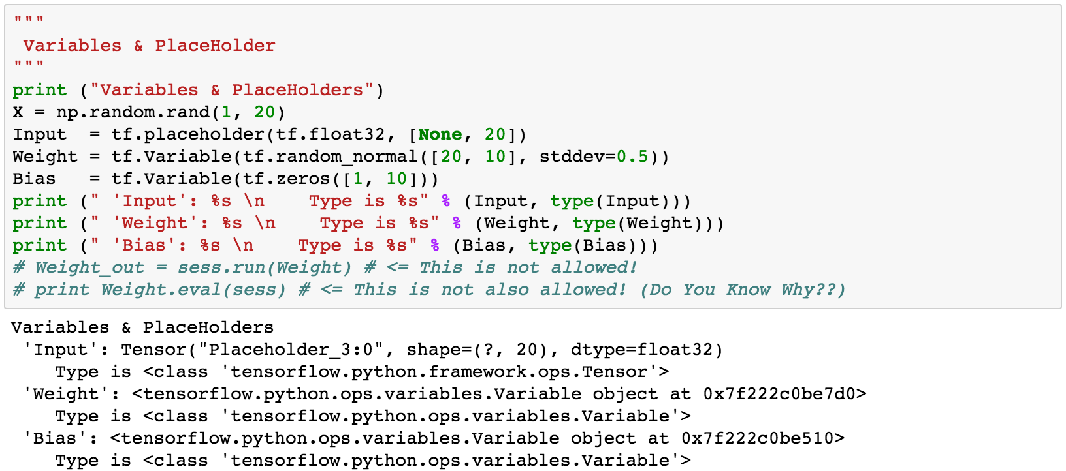
Placeholder & Variables

Slide 27
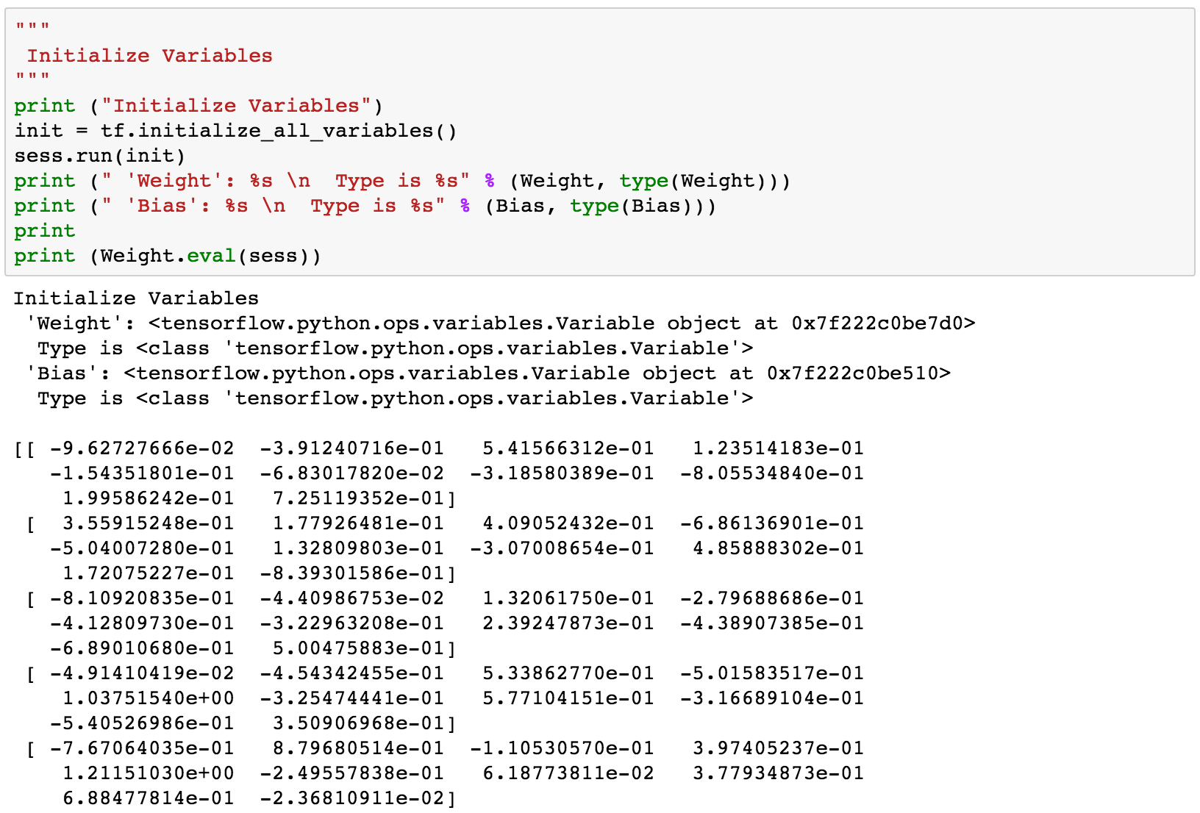
Initialize

Slide 28
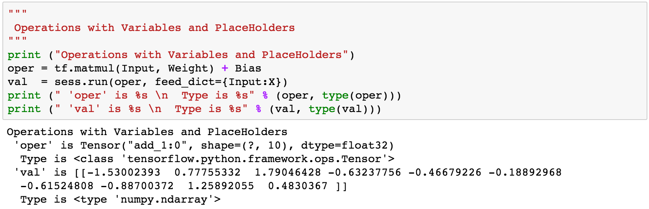
Operation

Slide 29
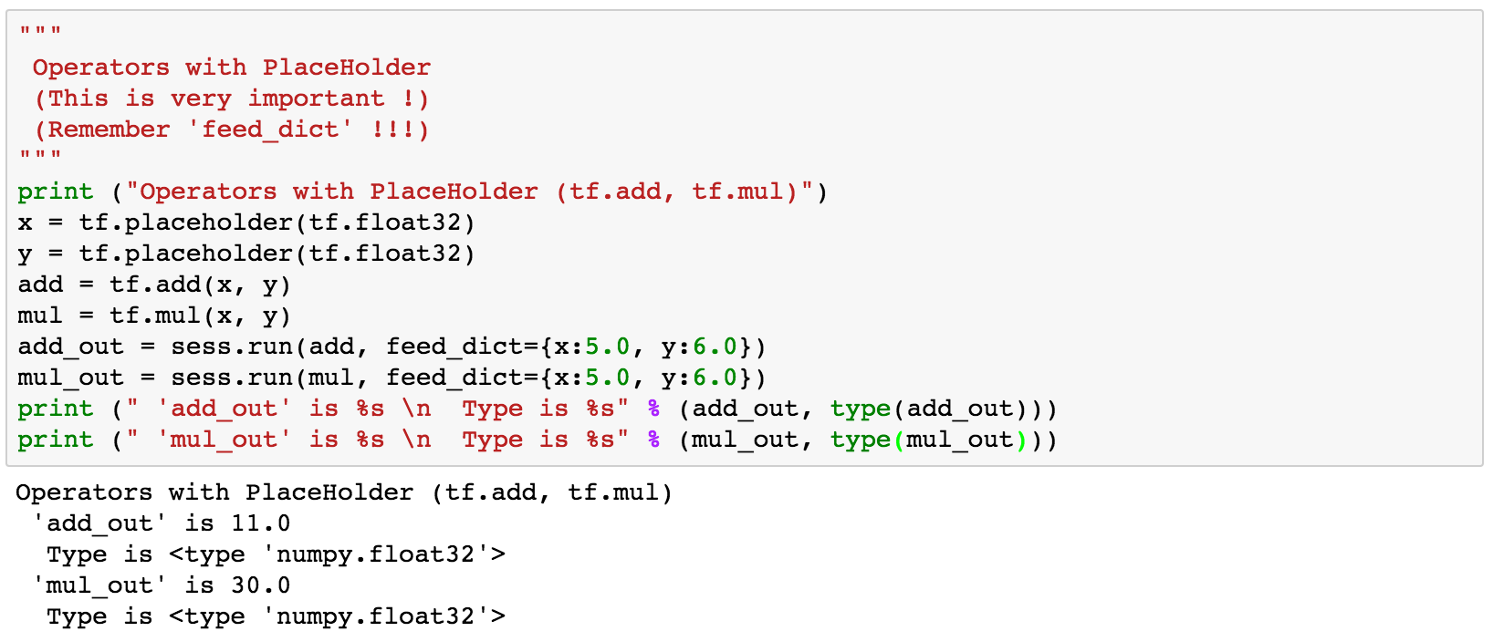
Operation

Slide 30
Must remember

Slide 31
Summary
Computational Graph (TensorFlow)
Optimizer
Loss
Operation
Variable
PlaceHolder

